Slide 1
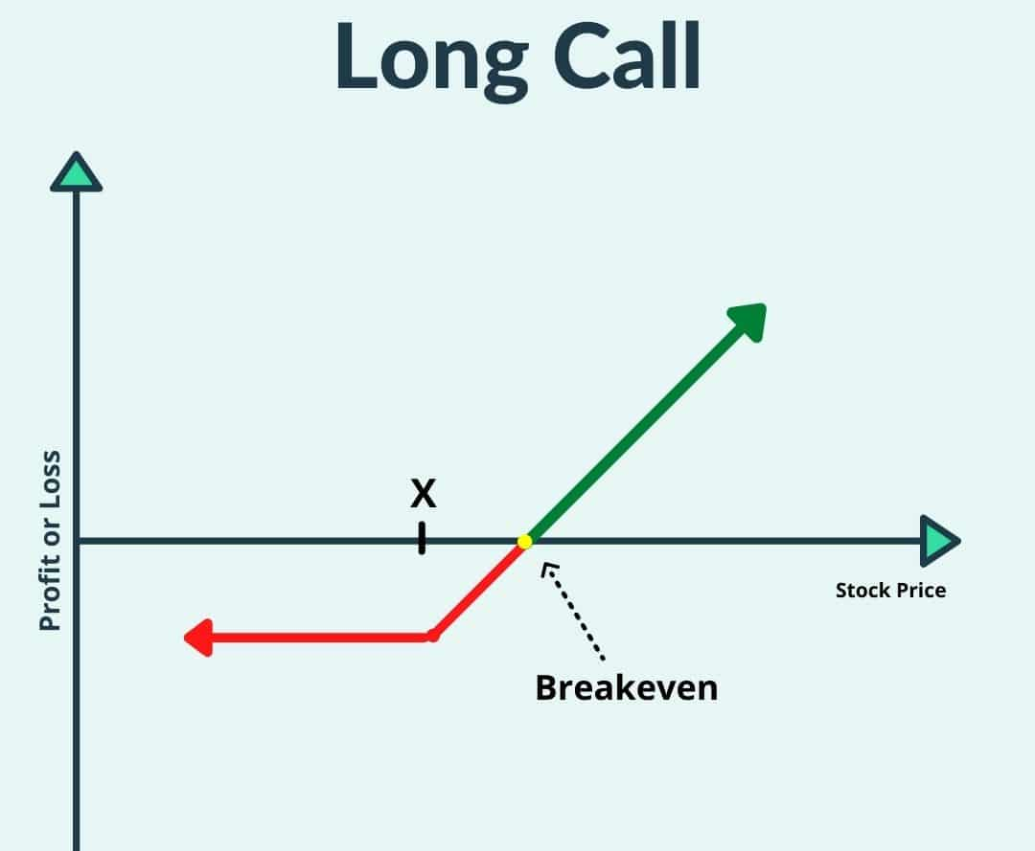
Options Pricing Through Generative Market Simulation
Kian Chakamian, Michael Incorvaia, Rajan Sandhu, Yosep Rhe
Background
Option: contract giving owner the right to buy/sell an asset at a specified price in some period
Useful for mitigating risk to a business or making strong directional bets
Motivation
Creating a fair option price is essential for all participants, and a competitive edge
Options are hard to price because:
  Many variables (strike price, time, volatility, interest rates, etc..)
  Uncertain future outcomes
  Non-linear payoff, full price distribution matters
Traditional mathematical models have restrictive assumptions
  Ex: Black-Scholes assumes constant volatility
Can a generative model better capture complex market behavior?
  Explainability vs. Flexibility

Slide 2
Options Pricing Through Generative Market Simulation
Kian Chakamian, Michael Incorvaia, Rajan Sandhu, Yosep Rhe
Idea
Use generative model to generate many price movements sequences, then calculate option price using expected value of payoff
Test autoregressive models, normalizing flows, GANs, etc. to find best for this application
Compare generated prices with actual payoffs, current marketplace values, traditional models
Approach
Methods: train model on historical price movements, generate new sequences, calculate discounted EV price
  Try both individual stocks, clusters of similar stocks
Models: RNADE, Normalizing Flow, GAN
Datasets: yfinance (from Yahoo! Finance’s API)
Backtesting: compare prices from our different models against real/traditional prices, Black-Scholes-Merton pricing

Slide 3
Options Pricing Through Generative Market Simulation
Kian Chakamian, Michael Incorvaia, Rajan Sandhu, Yosep Rhe
Status
Complete: Historical data generator, RNADE module, discounted EV calculator
In-Progress: Fine-tuning/improving RNADE model, training normalizing flow and GAN
Timeline
Expected Outcomes
Reasonable options prices when compared against real payoffs, Black-Scholes-Merton pricing
An understanding of which generative models perform best for this application
Testing generative approaches to options pricing application and identifying shortcomings
October 25th
November 9th
November 25th
Deadline: December 7th
Initial Testing and Pitch
Model Dev and Tuning
Model Characterization
Final Presentation
Validate idea with RNADE model test and create pitch
Compare performance of different models for this task and characterize performance
Choose a base model, iterate on it for better performance and characterize it for presentation
Work on final project presentation

